Slide 1


CAP785 WEB PERFORMANCE OPTIMIZATION

Slide 2
INTRODUCTION
When images are served with responsiveness in mind, users are getting the best experience that their devices are capable of. For instance, one large image can scale down well for all devices, but it isn’t the best choice even if it looks great for all devices. The device has to take an image that’s grossly oversized and rescale it to fit the screen. This image will also have a larger file size, thus taking more time to download.
This impairs performance.
Instead, it makes more sense to serve images to best fit the device’s needs

Slide 3
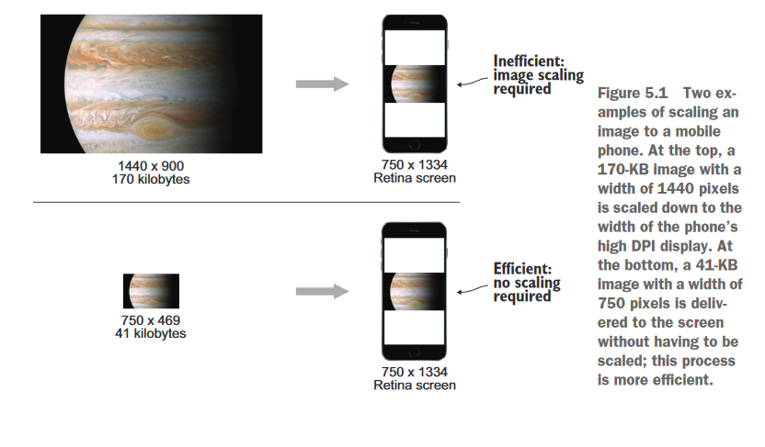
Responsive Vs UnResponsive Images

Slide 4
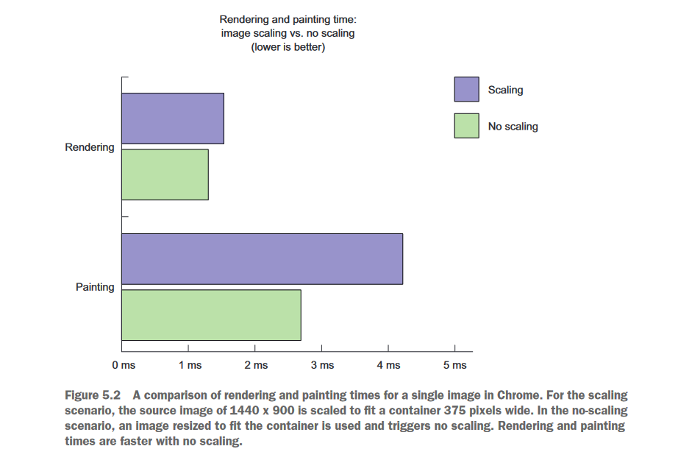
Comparative Analysis Responsive and UnResponsive Images

Slide 5
IMAGE FORMATS
JPEG (Joint Photographic Experts Group)
JPEG was used for photographs.
JPEG is a lossy compression method (there is a lossless mode, but it’s not widely supported), and is well-suited to photographic images, which typically have many different colors and gradients.
With JPEG, there is a trade-off between file size and image quality, but even at the lowest compression level (that is, the largest file size), JPEG images are still considerably smaller than nonlossy formats such as TIFF (which stands for Tagged Image File Format).
JPEG compression levels are usually specified as either a percentage (where 0 percent is the smallest file size, but lowest quality, and 100 percent is the best quality, but largest size) or a number in the range 0 to 1.
A value of approximately 60 percent to 80 percent is generally considered a good middle ground for web images.

Slide 6
IMAGE FORMATS
GIF (Graphics Interchange Format)
GIF was used for computer-generated images such as icons.
GIF has been around since 1987 and is commonly used for logos, sprites, and clip art.
GIF images use a color table (also known as a palette), which can hold up to 256 colors. Each pixel of the GIF image is then replaced by a number representing which of these colors it contains.
The limitation here is that a GIF can contain only 256 different colors at most.
GIF compression is based around LZW, a revised version of the LZ78 algorithm, which is used in gzip and deflate.

Slide 7

IMAGE FORMATS
Because compression occurs in horizontal rows (from left to right), images that contain a horizontal color gradient compress worse than those with a vertical gradient.
Consider the images shown below. The image on the left weighs in at 25 KB, whereas the one on the right is only 17 KB.

Slide 8
IMAGE FORMATS
PNG (Portable Network Graphics)
PNG is a lossless format that was designed as a replacement for GIF after the licensing issues with LWZ became apparent. PNG uses the deflate algorithm (which itself uses LZ77).
PNG supports both paletted and non-paletted RGB and RGBA (RGB with an alpha channel) images.
PNG8 is the most similar to GIF, using an 8-bit (that is, 256) color table. In most cases, it outperforms GIF.
The RGB mode (PNG24) is sometimes also used as a lossless alternative to JPEG; although the large file size means this is not commonly used on the web.

Slide 9
IMAGE FORMATS
SVG (Scalable Vector Graphics )
The image formats examined thus far all work along similar principles, containing information on the color of each pixel in the image. What differs is the way in which this information is encoded.
SVG takes a completely different approach by using XML to describe an image in terms of geometrical shapes.
If you’ve ever drawn on a canvas in your favorite programming language, you’ll be familiar with the idea of specifying the dimensions of polygons, setting a fill color, overlaying text, and so on. Following is the content of a simple SVG file:
<?xml version="1.0"?>
<!DOCTYPE svg PUBLIC "-//W3C//DTD SVG 1.1//EN"
"http://www.w3.org/Graphics/SVG/1.1/DTD/svg11.dtd">
<svg xmlns="http://www.w3.org/2000/svg" version="1.1">
<circle cx="100" cy="50" r="20" stroke="black" stroke-width="1” fill="blue" />
</svg>

Slide 10
IMAGE FORMATS
This draws a circle on the canvas with radius 20 pixels at coordinates 100 × 50 pixels. The circle is filled with a blue color, and has a black border of radius 1 pixel. Aside from circles, ellipses, polygons, and text, SVG also supports color gradients, filters, blur effects, and drop shadows.
In many situations, SVG is an ideal alternative to traditional image formats. It can result in smaller file sizes (sometimes, but not always), and (as the name implies) is scalable, meaning that the image can be resized without affecting its quality.
One of the main reasons why the SVG format is not as widely used as it should be is because of poor support in IE.

Slide 11
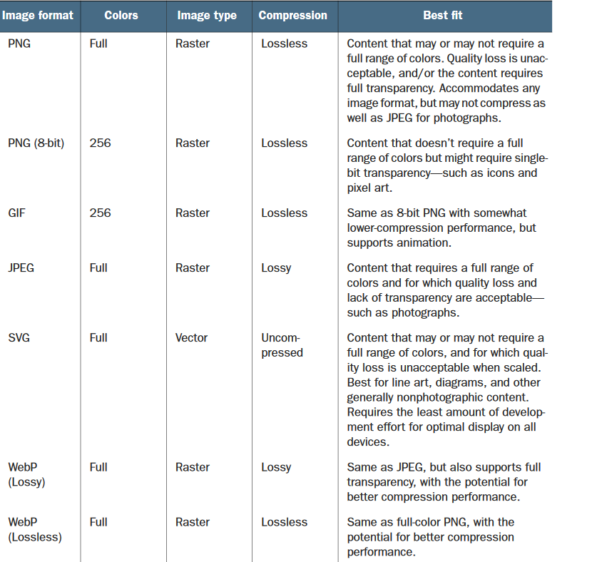
Which Format to Choose?

Slide 12
Image Delivery in CSS
When implementing responsive images using CSS , the best tool for the job is the media query. With media queries, you can decide at which screen width you should
change a background-image rule for a particular selector.
On your website, if only one selector has a background-image property set, and that’s the #masthead selector. It sets the styling for the top of the page,which has a large background image, logo, and site tagline.

Slide 13
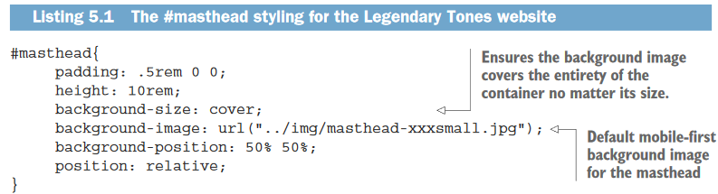
CSS for this selector

Slide 14
The #masthead element spans the width of the browser window and has a background-
image value of masthead-xxxsmall.jpg. If you load this website on large screens, you’ll
immediately notice how poor the visual quality of the background image is. This is because
the default styling is mobile-first, so the smallest image meant for mobile devices is served

Slide 15
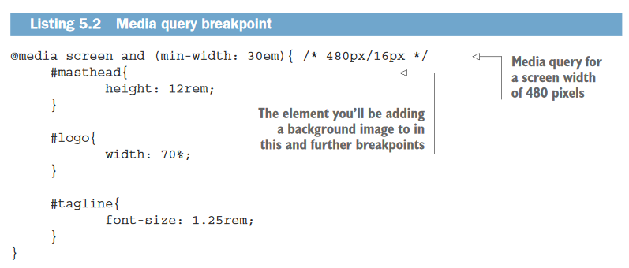

Slide 16
What you want to do with this code is modify the #masthead selector’s content to provide a higher-resolution background image than masthead-xxxsmall.jpg when this breakpoint kicks in. So go ahead and change the content of the #masthead selector to the following:

Slide 17
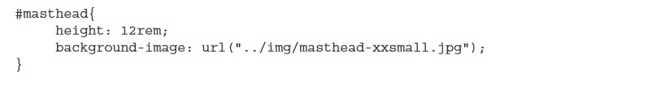
After you add the background-image property for the new image, save the document
and reload the page. Then observe the improvement in image quality

Slide 18
Using SVG background images in CSS
Sometimes it may be preferable to use SVGs in background images, depending on the
content of the image. If you have an image that contains a lot of line art, SVGs are perfect. When using these image types in CSS, no media queries are required for the image to display flawlessly across all resolutions and display densities.
In your website, change the background-image property in this selector to the following:
background-image: url("../img/masthead.svg");
Then remove all the media queries in the document, so the background image overrides in those media queries don’t override the SVG back-ground you’ve set. After you make these changes, save and reload the page to see the new background image.
When the new SVG goes into effect, resize the window and observe how the image
scales flawlessly at all resolutions. This is the primary advantage of SVG files at work.
No media queries required, the image scales properly at all device widths and screen
types, high DPI or otherwise.

Slide 19
Image delivery in HTML
In this section, you’ll learn about two approaches to using responsive images inHTML , both useful for different scenarios. These are the <picture> element and the <img> tag’s srcset attribute.

Slide 20
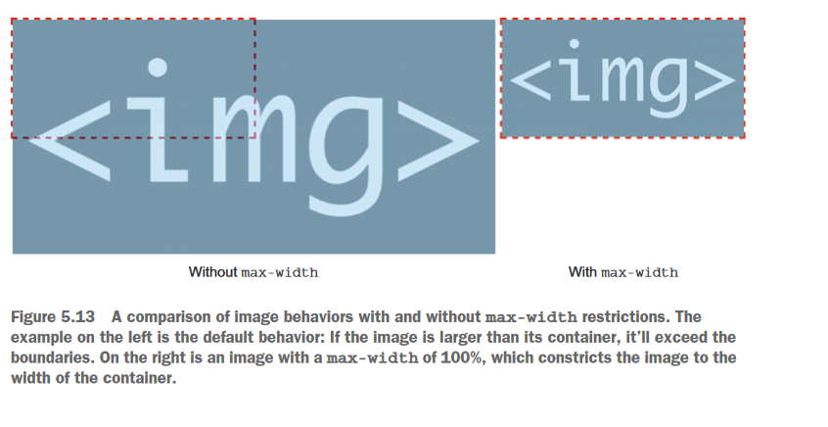

Slide 21
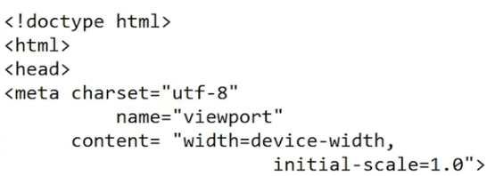
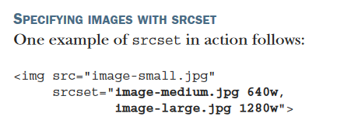
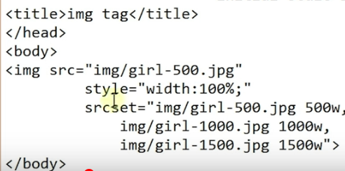
Using srcset

Slide 22
In this example, the src attribute is used for the default image, which in mobile-first sites, should be the smallest in the image set. This acts as a fallback for browsers that don’t support srcset . The srcset attribute here refers to two higher-resolution images The format that the srcset attribute takes is the image URL, and the width of the image, separated by a space. Image names are in the format you’d normally use in an <img> tag’s src attribute, and the width is denoted using the suffix w. For example, an image 512 pixels in width would be denoted as 512w. Additional images and dimensions can be added. Just separate them with a comma! The strength of srcset is that it doesn’t need media queries to work.

Slide 23
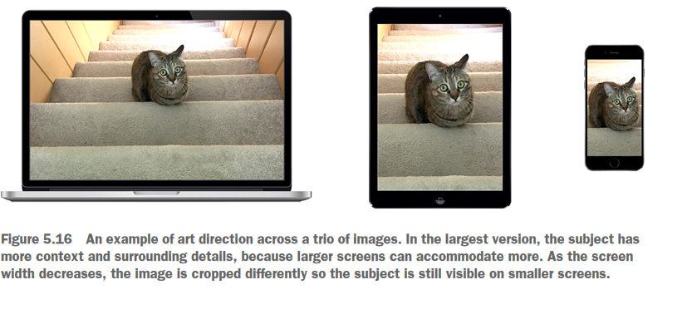

Slide 24
The srcset feature as used on the <img> tag isn’t a good fit for images that need different treatments in different breakpoints, because it requires that a set of images maintain the same aspect ratio. The <picture> element has no such requirement,and will display any image at any defined transition point

Slide 25
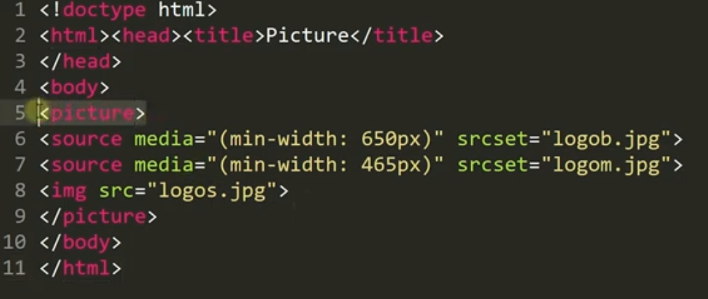

Slide 26
To achieve your goal, you add two <source> tags for different images. The first <source> tag contains a media attribute that takes effect when the screen is 704px or
wider. When this condition is met, the srcset attribute will provide an image 384px in width, and render it at a third of the viewport size. When the screen width is less than 704px , the second <source> tag kicks in. This <source> has an srcset attribute to bring in a different image treatment 320px in width, and sizes it to 75% of the viewport width.

Slide 27
Using SVG in HTML
You have two nearly universally supported options when it comes to using this
image format in HTML , and both methods provide the same benefits that you’ve seen
when placing SVGs into your CSS , in terms of visual quality and ease of use in respon-
sive web pages. The two options are:
1. Use the <img> tag—This is the most simple method, and you can try it for your-
self in index.html. The logo in the masthead points to a PNG version:
<img src="img/logo.png" alt="Legendary Tones" id="logo">.
An SVG version of the logo exists alongside logo.png in the img folder, named
logo.svg. To use it, point to img/logo.svg in the <img> tag’s src attribute:
<img src="img/logo.svg" alt="Legendary Tones" id="logo">.
When you make this change and reload the page, you’ll see the SVG version of
the logo in use. When you use an SVG file in an HTML <img> tag, there’s rarely
any reason to use it in a <picture> element or with srcset , unless you’re using
it in a <picture> element as a part of a series of image fallbacks.
2.Inline the SVG file— SVG s are XML , which is syntactically similar to and compatible
with HTML . Therefore, it’s possible to copy and paste SVG files directly into HTML .

Slide 28
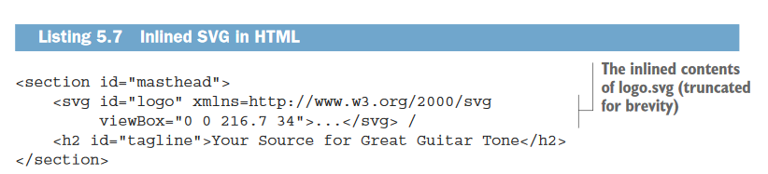

Slide 29
OPTIMIZING IMAGES
Image Editing Software
An array of image-editing software is available, but one is the GNU Image Manipulation Program (GIMP) (http://www.gimp.org). It’s free, it works on UNIX, Windows, and Mac, and it does a good job to compress images.
Although there are a large number of tools available specifically for optimizing images, they rarely result in any significant reduction in file size when run on images saved by GIMP.
Choosing the Right Format
The general rule for using the JPEG format for photography and GIF or PNG for everything else can serve you well most of the time.
But occasionally you encounter images somewhere in between — often images generated digitally that contain more than 256 colors, or lots of gradients. In these situations, trial and error is the best approach.
Experiment with different formats and different compression levels until you find the best trade-off between size and quality.

Slide 30
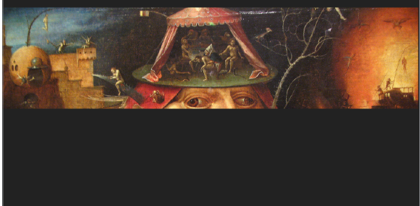
Interlacing and Progressive Rendering
The default compression method for JPEG is called baseline, in which the data is compressed from top to bottom. This leads to the well-known effect where a large JPEG image starts rendering from the top downward, as shown in Figure.

Slide 31
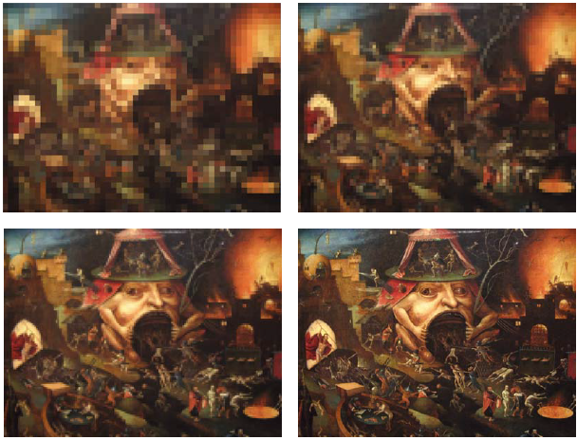
JPEG also offers a second method of compression, known as progressive, in which multiple passes are made of the image, each producing higher detail. When loaded in a browser, such images start out blurry and gradually become more detailed, as shown in Figure

Slide 32
In terms of usability and user perception of speed, progressive JPEG files are generally considered to be a good thing, especially for those who use slow connections.
Progressive JPEG files provide a rough overview of the image quickly, and the final stages of rendering are often unnoticed by the user. Not everyone feels this way, though.
There is the danger that the user is never quite sure if the image has finished loading, or sees the early passes and assumes the image is of a poor quality.
How does progressive rendering affect file size? It actually tends to reduce the size slightly; although this isn’t always the case.

Slide 33
GIF and PNG formats both support a similar technique (of which PNG’s is far superior), which is known as interlacing. As with progressive JPEGs, the idea is to show the image in multiple passes, each pass adding more detail.
With a GIF file, the first pass draws every eighth line, the second pass every fourth line, the third pass every second line, and the fourth (last) pass the remaining lines.
By contrast, PNG uses a two-dimensional interlacing scheme consisting of seven passes. The result is a much smoother transition with more clarity in the early stages of rendering.

Slide 34
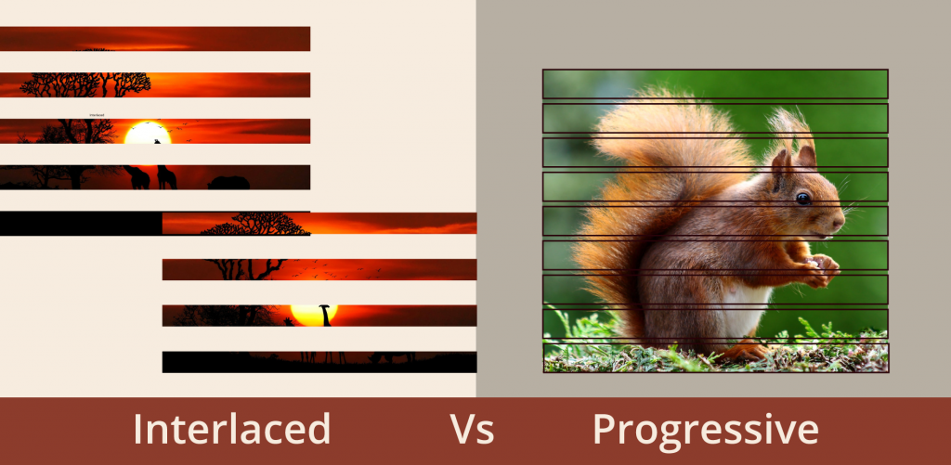

Slide 35
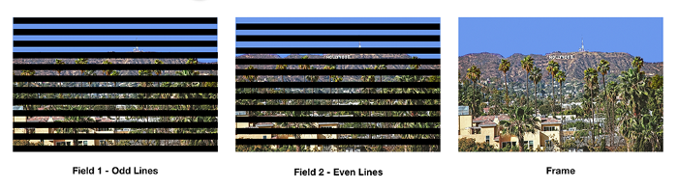

Slide 36

CSS SPRITES
The CSS background-image property enables you to set an image to be used as the background of a given element.
Figure shows an image that measures 554 pixels wide and 394 pixels high. To display this as a background image, you can use the following code:
<style>
.mybackground {
background-image:url('/images/flowers.png');
width: 554px;
height: 394px;
}
</style>
<div class="mybackground"></div>

Slide 37
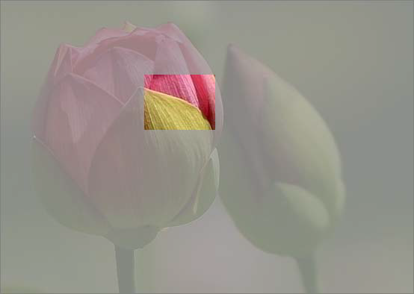
Using background-position, you can display only a section of the image. Now pick an arbitrary region inside the image as shown in figure.
The upper-left coordinates of the highlighted area are 193 pixels and 100 pixels, and the region is 95 pixels wide and 71 pixels deep. Thus, consider the following:

Slide 38

<style>
.mybackground {
background-image:url('/images/flowers.png');
background-position: -193px -100px;
width: 95px;
height: 71px;
border: solid 1px black;
}
</style>
<div class="mybackground"></div>
For added clarity, a small border has been put around the div.
As shown in figure, when you load this in a browser, only the selected region of the background image is shown.

Slide 39

We can join together multiple images into one larger montage, and then selectively show regions of this montage in the appropriate place.
This slashes the number of image requests, and the montage — or sprite, as it is more commonly called — is usually significantly smaller than the sum of the images it contains.

Slide 40
CSS sprites have a few advantages :
➤ The images no longer must be adjacent. Although the six icons are side-by-side in this example, they could just as easily be scattered across the page.
➤ Each image can be used multiple times, in different places.
➤ You retain the ability to set an alt attribute for each image, thus improving accessibility.

Slide 41
Drawbacks to Using Sprites
Although CSS sprites may seem too good to be true, there are a number of drawbacks to using them.
They are somewhat fiddly to create and implement — merging images, calculating pixel offsets, creating appropriate CSS rules.
If one sprite must be changed at a later date to an image of different dimensions, this can affect the offset of many of the other sprites.
GIF or PNG file is stored uncompressed in memory by the browser. Situations have occurred in which a huge (In terms of dimensions) background image — mostly consisting of whitespace — is used.

Slide 42
A disadvantage of background images in general is that when a page is printed, browsers tend not to include them.
Printing unnecessary images slows down printing and wastes ink, but sometimes these “background” images are an integral part of the page. In such situations, a separate style sheet for printing (using the media="print" attribute when linked to) can alleviate the problem.
You should not lose sight of the big picture. The overall aim is to improve page loading times, and although reducing the number of HTTP requests is usually beneficial, this isn’t always the case.

Slide 43
Palette Colors- An additional problem with sprites concerns the number of colors. Most likely, you’ll want to create a paletted master image in GIF or PNG8 format, both of which limit the number of colors that can be used.
And with an image containing a variety of sprites, you may find that there isn’t enough space in the color table to hold all the unique colors. The result is that the sprites look ragged or crudely drawn.
This problem can be partly mitigated by grouping sprites with similar color palettes and using several master images rather than one.
An alternative is to use a nonpaletted format, such as PNG24 or JPG — but you’ll likely pay a big price in increased file size. If it’s just one image that uses a dramatically different color palette than the rest, it may simply be best not to sprite it at all.

Slide 44
Automating the Process
Creating sprites is a tedious process, but a number of tools are available to automate the process. These range from simply spriting a series of images supplied by the user, to automatically parsing a page and then generating sprites and CSS for all images found.
CSS Sprite Generator
It creates a master image from a list of user-supplied images. It offers the capability to resize images, align horizontally or vertically, and can output in JPG, PNG, or GIF format. Optionally, supporting CSS can be generated, too. This is a valuable tool because it is simple, yet powerful, with plenty of options.

Slide 45
SpriteMe (http://spriteme.org/) uses the novel approach to run via a JavaScript bookmark. Simply visit the site you want to inspect, find SpriteMe in your bookmarks, and click it. The SpriteMe widget then loads on the page.
The widget lists all the images found on the page and notes those that are possible candidates for spriting, and those that are not (for example, because they repeat both vertically and horizontally). With just a few clicks, you can generate a master image, and SpriteMe can show you the changes you need to make to your CSS.

Slide 46
In some situations, you may need to create sprites programmatically.
With a little bit of magic (ImageMagick, that is), this is actually quite an easy task.
ImageMagick (http://www.imagemagick.org/) is a suite of command-line tools used for manipulating images, one of which — convert — can be used to join images together.
The syntax can be as simple as the following:
convert image1.png image2.png image3.png -append output.png
This creates a vertically aligned master image named output.png from the three specified files.
For a horizontally aligned master image, just use +append instead of -append.

Slide 47
convert accepts a whole host of other options, too, including the capability to set the image type (for example, paletted versus RGB), color depth, and transparency.
Following is an improved version of the previous command:
convert -type Palette -colors 256 -background Transparent image1.png image2.png image3.png -append PNG8:output.png.
This specifies a paletted PNG file with a transparent background, and a color depth of 256, which is probably closer to what you want. Although convert does a decent job to keep the file size down, you may still want to pass the resulting image through something like pngcrush.

Slide 48
CSS PERFORMANCE
CSS in the Document Head
With JavaScript, it is advantageous to load external scripts as late as possible. With CSS, the opposite is true.
Most browsers delay rendering a page until the CSS has been downloaded to avoid a repaint/redraw, so it’s usually best to place links to external style sheets in the <head> of the document.
Unlike JavaScript, these links do not block, and the browser can happily continue with downloading other content.

Slide 49
Inline versus External
The decision on whether to include CSS inline or as an external file boils down to the trade-off between the number of HTTP requests and cachability.
If you include the CSS inline, you eliminate an HTTP request but increase the size of the HTML document.
If you use an external style sheet, you have an additional HTTP request, but the resource can be more readily cached. (Most of the time, you don’t want to cache the HTML document because it has been dynamically generated.)

Slide 50
Link versus @import
Most of the time, you want your style sheet to be external, but you then have the choice of whether to use <link> or @import to load the resource.
This is an easy decision. Stick with <link> because it is nonblocking, and can enable other resources to download in parallel.
What happens when you mix @import with <link>. All cause blocking behavior to some extent, and because there isn’t a valid reason for favoring @import over <link> in the first place (old browsers don’t support @import, so it can be used as a hack to stop them from loading the CSS), the solution is simply not to use it.

Slide 51
Redundant Selectors
Over time, your style sheets can become rather messy and out of sync — duplicate rules are added, elements are removed from the HTML document, but the developers forget to remove the CSS selectors, and so on.
The result is redundant selectors adding unnecessary weight to your style sheet. Of course, in theory, this shouldn’t happen.
Your development and deployment process should be rigorous enough to ensure that the CSS is kept in sync. But, in practice, it does happen.

Slide 52
CSS Expressions
Avoiding the use of CSS expressions was once one of the most important rules for CSS performance.
CSS expressions were a way to set CSS attributes dynamically using JavaScript embedded in the style sheet.
Unfortunately, the rules are re-evaluated every time the browser window is resized or scrolled, or the mouse is moved. The result is that an expression can easily be re-evaluated thousands of times during a page view.
Although the expressions are generally fairly light, with this number of executions, performance can suffer.
You can use expressions that will be evaluated only once, but almost always the same end result can be achieved using pure JavaScript — which isn’t IE-specific and isn’t deprecated.

Slide 53
Selector Performance
The performance of CSS selectors has received a lot of attention in the past few years, mainly because of some well-publicized benchmarks showing a dramatic drop in performance under certain conditions.
Selectors are parsed from right to left. Consider the following example:
#body div div p {
background:red;
}
When the browser hits this rule, it goes through every <p> element in the page and checks whether it is the child of a <div> tag. Then it checks if this div is the child of another div, and if this other div is the child of an element with ID body.

Slide 54
This seems like quite a lot of work, and the obvious conclusion is that you should keep your chain of selectors short to minimize all this backtracking.
Consider the following:
#body div div p .highlight {
background:red;
}
This time, you match elements only with class="highlight", so, although you have the same level of nesting, the more specific selector means that less elements are going to match.

Slide 55
Using Shorthand Properties
Many CSS properties support a shorthand notation that is much quicker to write, which can make a big impact on the size of the style sheet.
One example is when specifying colors. Generally, a hex triplet is used, with two digits for each RGB part (for example, #F368C4, where F3 is the red component, 68 the green, and C4 the blue). When the two digits in each part are the same, you can omit one of them; thus, #FF99CC becomes #F9C.

Slide 56
With the margin and padding properties, the longhand way is to write them like so:
margin-top:5px;
margin-bottom:4px
margin-left:3px;
margin-right:2px
However, this can be simplified to the following:
margin:5px 2px 4px 3px
Notice the order of the values. You start at the top and go around clockwise — so the top margin first, then the right margin, then bottom, and then left.
If the top and bottom values are the same, and so, too, are the left and right, you can simplify things further, as shown here:
margin: 10px 5px
With only two values passed, browsers assume that the first refers to the top and bottom margins, and the second to the left and right margins.

Slide 57
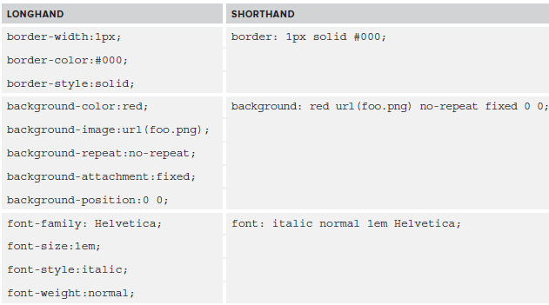
There are many other shorthand notations.

Slide 58
Inheritance and Default Values
Some of the biggest savings in CSS come from knowing when properties can safely be omitted — either because they have been inherited from a parent element, or because the default value is appropriate.

Slide 59
Doing More with CSS
In many situations, it makes sense to use CSS more rather than less because it’s the most efficient option.
Certainly, placing style rules in an external style sheet (cacheable by the browser) is generally a better option than embedding the rules in the HTML document. (The exception is when there are a large number of rules used only on one page — here, inlining is sometimes better.)

Slide 60
CSS versus Data URIs
CSS sprites isn’t always practical to convert images to sprites sometimes because of the color table, and sometimes because of horizontal and vertical repetition.
In these situations, data URIs are an excellent solution. Image data can be directly embedded into the document with data URIs

Slide 61
Mouse-Over Techniques
Using CSS, rather than JavaScript, for mouse-over effects (for example, in menus) is a popular option.
Previously, this was the preserve of JavaScript. But for basic effects, CSS is better suited, and can do a lot — pop-over windows, image switching, pull-down menus, and so on.
Aside from being more elegant, this method works even if the client does not support JavaScript (or has it disabled)
Unfortunately, CSS solutions lack many of the keyboard navigation shortcuts, and JavaScript still has the edge here.

Slide 62
For example, to swap an image with another one when the mouse is moved over it, the HTML and CSS is simply as follows:
<span class="swap">
<img src="image1.png" />
</span>
span.swap {
background-image: image2.png;
background-repeat:no-repeat;
display:block;
}
span.swap:hover img{
visibility:hidden;
}

Slide 63
Creating Rounded Corners
Rectangular boxes are so 1990s. These days, site owners want pleasing boxes with rounded corners.
There are a number of ways to achieve these, but most are rather ugly, rely on creating images for each corner, and possibly the use of HTML tables.
CSS comes to the rescue by defining the border-radius property, which can be used to round the corners of a rectangular box.

Slide 64
Creating rounded corners in CSS is currently best achieved using rules such as the following:
.roundedcorner
{
-moz-border-radius: 5px;
-webkit-border-radius: 5px;
-khtml-border-radius: 5px;
border-radius: 5px;
}
-moz-border-radius is Mozilla’s name for the property and is supported by most Geckobased browsers (Firefox, Konqueror, and so on).
-webkit-border-radius is used by WebKit-based browsers such as Chrome and Safari
-khtml-border-radius is for older versions of Konqueror.
border-radius is the accepted CSS 3 name

Slide 65
<!DOCTYPE html>
<html>
<style>
#rcorners3 {
-webkit-border-radius: 25px;
background: url(paper.gif);
background-position: left top;
background-repeat: repeat;
padding: 20px;
width: 200px;
height: 150px;
}
</style>
</head>
<body>
<h1>The border-radius Property</h1>
<p>Rounded corners for an element with a background image:</p>
<p id="rcorners3">Rounded corners!</p>
</body>
</html>

Slide 66
Other Formats
MNG
One of the main reasons that the GIF format hasn’t died out on the web is that its replacement, PNG, doesn’t support animation.
Although this may seem like an oversight by the creators of PNG, it was intentional — because they were also developing the lesser known Multiple-Image Network Graphics (MNG) format specifically for animation.
Although the idea of the MNG format began at approximately the same time as PNG, its development has slowed down, and the format hasn’t caught on.
As of 2012, only Konqueror supported the format natively, although plug-ins are available for IE, Firefox, and Opera.

Slide 67
APNG
Animated Portable Network Graphics (APNG) is an extension to PNG, and offers features similar to MNG.
Its chief advantages over MNG are better browser support and a less-complicated format.
Currently, Opera and the Gecko-based browsers are the only ones that support APNG natively, although Chrome supports it via a plug-in.

Slide 68
PNG Optimization
Optimization of PNG images can be divided into four steps:
1. Remove redundant headers.
2. Reduce the color depth. (For example, switch from RGB to paletted, or reduce the number of colors in the palette.)
3. Re-implement or use alternative filters.
4. Improve the performance of the LZ77 and deflate algorithms. Sometimes custom implementations are used.

Slide 69
Removing Redundant Headers
This step involves removing meta data that is not of the image itself. As such, there is no loss in image quality; although whether this step can truly be referred to as lossless is debatable because data is still being removed.
The PNG format supports more than a dozen additional headers, which are not required to be present, and many can be omitted without ill effect.
Following are prime candidates for removal
➤ bKGD — Specifies a default background color. This option is not used by web browsers.
➤ pHYs — Gives the intended aspect ratio or pixel size of the image.
➤ sBIT — Stores the number of significant bits.
➤ HIST — Contains a palette histrogram, charting how frequently each color appears in the image.
➤ tIME — The last modified time of the image.
➤ cHRM —Stores the X/Y coordinates of the primary colors used in the image.

Slide 70
Reducing the Color Depth
This step is not required because you should already have experimented with setting the lowest acceptable palette depth.
While it is common knowledge that PNG8 supports binary transparency (that is, a pixel is either transparent or it is not), less well-known is the fact that PNG8 also supports alpha transparency.
If you have been using PNG32 simply because you needed alpha transparency, now is the time to experiment with PNG8. File sizes should be significantly smaller.
The most frequent problem with alpha transparency in PNG32 is the buggy support in earlier versions of IE. Versions 6 and earlier could not handle the alpha channel, and would render alpha pixels in grey, with less than pleasing results.
While IE6 still does not support alpha transparency in PNG8, it chooses to display such pixels as fully transparent, which is usually more acceptable.

Slide 71
Re-Implementing (or Using Alternative) Filters
At the pre-compression stage, filters can transform the data into a form that can compress easier.
LZ77 looks for repeating sequences, and anything you can do to increase these can aid compression.
Consider the following sequence:
1,2,3,4,5,6,7,8,9
With no repeating sections, this sequence offers no scope of LZ77 compression.
Yet, there is a definite pattern — each value is one more than the previous. Let’s apply a filter where each value in the sequence is replaced with the difference between itself and the previous value. (So, for example, the difference between 5 and 6 is 1, the difference between 6 and 7 is 1, and so on.) The sequence now looks like this:
1,1,1,1,1,1,1,1,1
This is the kind of data that LZ77 loves, and provided that you know the filter that was applied, you can easily reverse it to recover the original string.
Consider the following sequence:
2,3,4,5,2,3,4,5,2,3,4,5
Here, the filtered sequence would be as follows:
2,1,1,1,-3,1,1,1,-3,1,1,1

Slide 72
This actually compresses a little less. You might say that it compresses less for this particular filter.
PNG currently offers five different filters (although the first simply says “no transformation is made”),and a different filter may be used on each row of the image. The four remaining filters are as follows:
➤ Sub — Each pixel is replaced with the difference between it and the pixel to its left (as in the earlier example).
➤ Up — Each pixel is replaced with the difference between it and the pixel above it (that is, in the previous row).
➤ Average — Each pixel is replaced with the difference between it and the average value of the pixels above and to the left of it.
➤ Paeth — This is a much more complex filter based around the Paeth Predictor and using pixels to the left, top, and top left.

Slide 73
Improving Algorithm Performance
Having removed meta data and reduced the size of the raw image, the last possibility for optimization is in the compression.
PNG uses the deflate algorithm, deflate uses a combination of LZ77 and Huffman encoding
LZ77 is a dictionary coder that looks for sequences of data that match sequences that have already been encoded.
Such sequences are then replaced with a length-distance pair representing the size and offset of the earlier occurrence.
Huffman uses a tree structure (usually referred to as a table) to encode frequently occurring symbols into shorter representations.

Slide 74
In deflate tools (such as gzip) that enable the compression level to be set, the size of this window is typically one of the factors that can be changed.
The zlib implementation offers nine levels of compression, but if you’re happy with trading slower compression for smaller file sizes, there’s no reason why you cannot go beyond this.
As such, custom deflate implementations tend to offer the capability to set larger window sizes.
Output from LZ77 is piped to the Huffman encoder, and the buffer is flushed when it reaches a maximum size.
Raising the size of this buffer allows a larger, more organized tree.

Slide 75
Step 1 involves the potential loss of meta data in the image headers, even if this has no effect on image quality.
Step 2 can be lossless or lossy, depending on the situation. Shrinking the palette to remove unused colors is lossless, but sometimes it may be acceptable to lose a few colors for the sake of size, in which case loss does occur.
The final two steps are always lossless.

Slide 76
GIF Optimization
GIF offers less scope for optimization, and optimization techniques tend to be somewhat pedestrian — reducing the size of the palette to a visually acceptable level and removing unnecessary meta data.
GIF supports three sets of text-format meta data (usually referred to as extensions), and each may appear multiple times in the file. They are Comment, Plain text, and Application. All may safely be removed.

Slide 77
JPEG Compression
JPEG compression is something new and quite different from the LZW family of encoding schemes.
Whereas LZW and LZ77 perform lossless encoding, JPEG encoding is intentionally lossy — this is where most of the savings occur.
Unfortunately, JPEG compression is a significantly more complicated technique than deflate or LZW

Slide 78
Compression Internals
The first step in compression is to convert the image from RGB to YCbCr (where “Y” is the brightness,“Cb” the blue chrominance, and “Cr” the red chrominance).
Humans are much less sensitive to changes in chrominance than brightness, and the YCbCr color space takes this into account, allowing the image to be compressed more without a noticeable loss in quality.
To achieve this compression, down-sampling is then applied to reduce the resolution (and, thus, the level of detail, and the size) of the Cb and Cr components.

Slide 79
Optimization
In addition to the quality level, you also have the ability to choose which sampling method to use.
This is typically the case in images with small amounts of fine detail, such as images with text on them.
➤ JPEG files excel with gradual changes in color. As such, adding a small amount of blur to produce softer edges can aid the compression process.
➤ Similarly, reducing the color saturation produces smoother color transitions, leading to better compression.
➤ Decreasing the contrast lowers the range of brightness, which again allows better compression.

Slide 80
Zonal Compression
Although having fine-grained control over the level of compression used for a JPEG file is useful, it can be somewhat inflexible because the same level of compression is applied to every part of the image.
Zone compression (also referred to as spatial, weighted, or regional compression) is a technique whereby different parts of an image are compressed at different levels.
This can lead to lower file sizes and better quality in the parts of the image that matter.
Zonal compression is ideally suited to JPEG photography where a main subject is set against a less important background — outdoor shots are a prime example.

Slide 81
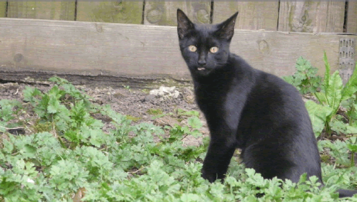
In the photograph shown in figure, the main focus is the black cat. Although it’s nice to appreciate the clarity of the weeds in the background, these are of secondary importance. You can reduce the file size significantly by applying a higher level of compression to this region.

Slide 82
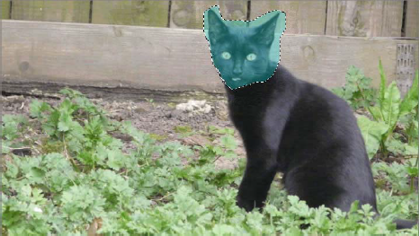
Although GIMP does not support zonal compression, both Adobe Photoshop and Fireworks do.
In Fireworks, you first select the region you want to keep at a higher quality using the Lasso tool, and then save it as a JPEG mask (Modify ➪ Selective JPEG). The masked area is highlighted in a different color, as shown in figure.

Slide 83
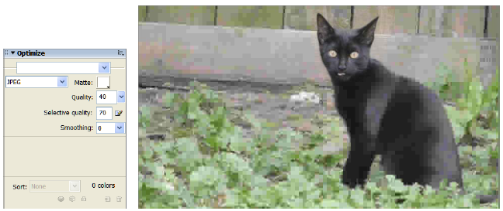
Finally, you can use the Optimize dialog to set the quality level of the highlighted region (“Selective quality”) and the remainder of the image (“Quality”).
Figure shows the original image with a quality level of 70 for the cat’s face and 20 for the background. (A low quality level has been used so that the differences in compression are more pronounced.)

Slide 84
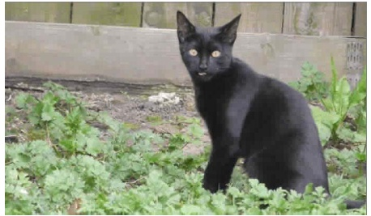
Figure shows a more realistic quality level of 70 for the face and 40 for the background. This results in a file size of 24 KB — a significant saving on the 42 KB size when the entire image is saved at a quality level of 70.

Slide 85
Image Optimization Software
PNGOUT (http://advsys.net/ken/utils.htm#pngout) is a freeware tool, available for Windows and Linux. It uses a custom implementation of the deflate algorithm, which results in better compression, at the expense of speed.
pngcrush (http://pmt.sourceforge.net/pngcrush/) is an open source tool for manipulating PNG images. One of its most useful features is a “brute force” mode in which it will attempt every possible combination of optimization options to find which give the best (smallest) file size.
advpng (part of AdvanceCOMP, at http://advancemame.sourceforge.net/comp-readm.html) also uses a custom implementation of deflate, this time from the 7-Zip program.
OptiPNG (http://optipng.sourceforge.net/) is an improved version of pngcrush, offering automatic reduction of bit depth and color palette. It also features a “brute force” mode, which outperforms pngcrush in many ways.
RIOT (http://registry.gimp.org/node/20778) is a Windows-only plug-in for GIMP that offers a huge array of optimization techniques for PNG, GIF, and JPEG.
GIFSicle (http://www.lcdf.org/gifsicle/) can be used on both animated and inanimate GIFs to remove comments, redundant colors, and so on.
JPEGTran (http://jpegclub.org/) can strip comments and other meta data, and can perform lossless editing.

